Slide 1


C Programming: Data Types and Variables
Learn the fundamental data types and how to use variables effectively in C programming for precise and efficient code.
by Istiak Rahman

Slide 2

Case Sensitivity and Statement Terminators
1
Case Sensitivity
2
Statement Terminators
C is case-sensitive. This means that "variable" and "Variable" are treated as distinct identifiers. The compiler will interpret them as separate entities, leading to potential errors if they are used interchangeably.
Every statement in C must end with a semicolon (;). This symbol acts as a signal to the compiler, indicating the completion of a command. It ensures that instructions are parsed correctly and executed in the intended sequence.
3
Example
4
Code
The following C code demonstrates the use of case sensitivity and the semicolon as a statement terminator:
int x = 5;
printf("Hello, World!");

Slide 3
Data Types and Variables: Storing Information
int: Integers
float and double: Floating-Point Numbers
char: Characters
The int data type is used to store whole numbers (integers). It typically occupies 4 bytes of memory (depending on the platform). For example: ```int age = 30; ```
The `char` data type is used to store single characters. It typically occupies 1 byte of memory. These characters can be letters, digits, punctuation marks, or special symbols. For example:
The `float` and `double` data types are used to store decimal numbers. `float` provides single-precision floating-point representation, typically using 4 bytes, while `double` offers double-precision, usually taking 8 bytes. This results in greater accuracy for `double`. For example:
This declaration creates a variable named `age` and assigns the integer value 30 to it.
```char initial = 'A'; ```
This declaration creates a variable named `initial` and assigns the character 'A' to it.
float salary = 45000.50; double pi = 3.14159;

Slide 4
Declaring and Initialising Variables: Giving Data Meaning
Declaration
A declaration tells the compiler what type of data a variable will hold, allowing it to reserve enough memory space for it. For example, to declare an integer variable named `age`, you would write: ```int age; ```
Combined Declaration and Initialization
You can declare and initialize a variable in one step. For example: ```float salary = 45000.50; ``` This line declares `salary` as a float and sets its value to 45000.50 at the same time.
1
2
3
Initialization
Initialization sets the initial value of a variable. This value is stored in the memory space allocated for the variable. To initialize the `age` variable to 25, you would write: ```int age = 25; ``` This code declares `age` as an integer and assigns it the value 25.

Slide 5
Keywords and Identifiers: Building Blocks of C Programs
Keywords
Identifiers
Keywords are reserved words in C with specific meanings. They are like building blocks for your code. You can't use them for names like variables.
Identifiers are names you choose for things in your program, like variables or functions. They help organize your code.
Identifier Rules
Examples of Identifiers
Identifiers must start with a letter or underscore (_), can include letters, numbers, and underscores, and can't use spaces or special characters. They also cannot be keywords.
int totalMarks; // Valid identifier
float averageScore; // Valid identifier

Slide 6
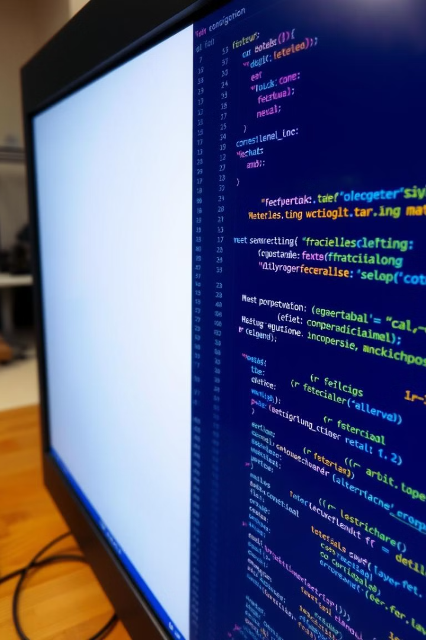



Constants and Literals: Representing Fixed Values
Constants
Constants represent fixed values that do not change during program execution. They are often used to represent values that should remain consistent throughout the program. You can define constants using the `const` keyword. For example: ```const int MAX_AGE = 100; ```
Literals
Literals are values that are directly assigned in your code. These values are treated as constants within the program. Examples include: * **Integer literals:** 25, 100, -5 * **Floating-point literals:** 3.14, 2.718 * **Character literals:** 'A', 'b', '!' * **String literals:** "Hello, World!"
Example Using Literals
The following code demonstrates the use of literals:
int a = 25; // Integer literal
float b = 3.14; // Floating-point literal
char c = 'A'; // Character literal

Slide 7
Key Concepts: Understanding Data Types and Naming Conventions
Concept
Explanation
Example
Use of Data Types
Choose the right data type for the data you're storing. Use `int` for whole numbers, `float` or `double` for decimal numbers, and `char` for single characters.
```c int age = 25; // `int` for a whole number float salary = 45000.50; // `float` for a decimal number char initial = 'A'; // `char` for a single character ```
Variable Naming Conventions
Give variables clear names that describe what they hold. Use lowercase letters and separate words with underscores. Don't use C keywords as names.
```c int totalMarks; // Good int averageScore; // Good int myVariable; // Good int 2ndValue; // Bad (starts with a number) int float; // Bad (a keyword) ```

Slide 8

Thank You!
Presented by: Istiak Rahman
Email: istiak.rahman1020@gmail.com
Thank you for your attention! I appreciate your time and interest.
Keep Learning, Keep Growing

